Slide 1

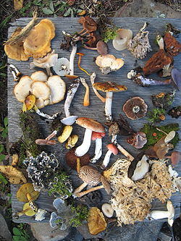
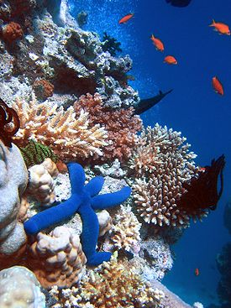
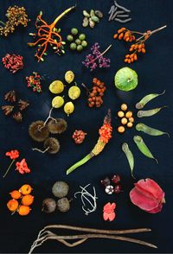
(Introduction to Environmental Studies) B. Tech 3rd Semester
BIODIVERSITY (PART-1)
Unit 2
Natural Resources
Department: Chemistry
Subject: Environmental Studies (CHM2041)

Slide 2
Contents
What is Biodiversity
Types of Biodiversity
Values of Biodiversity
Global Biodiversity
Biodiversity in India
Hot spot Biodiversity
Notes:
2

Slide 3
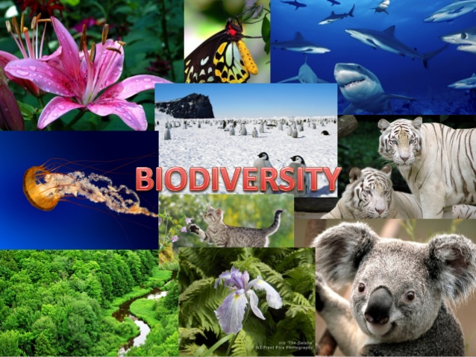
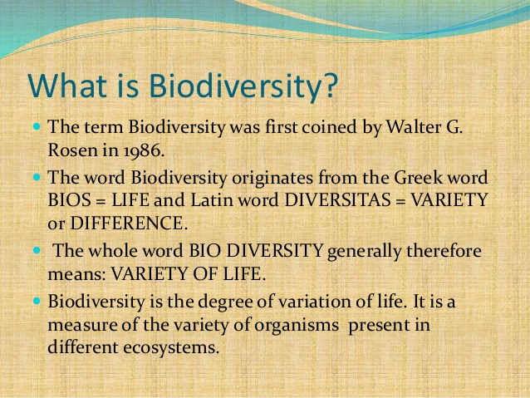
What is Biodiversity
Biodiversity: It is concerned with the variety of individuals within populations, the diversity of species within communities, and the range of ecological roles within ecosystems

Slide 4
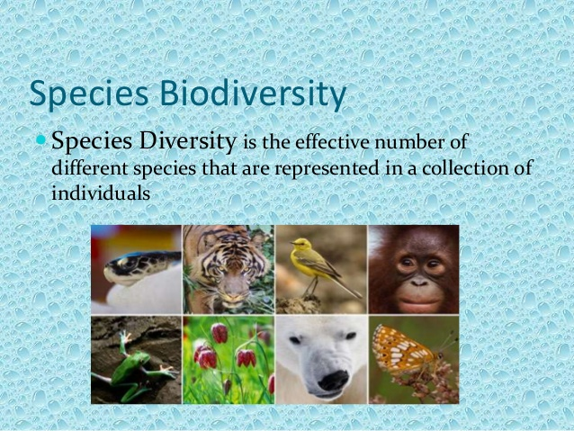
Types of Biodiversity
1) Species biodiversity, 2) Genetic biodiversity, 3) Ecosystem biodiversity
1. Species Biodiversity:
i) Refers to the variety of species within a community in a region.
ii) It an index represents species richness and their abundance in a community.
ii) At present, about 1.8 million species on Earth.
iii) India is among the world’s 15 Nations that are exceptionally rich in species diversity.
It is the variety of different species in a given area/Communities

Slide 5
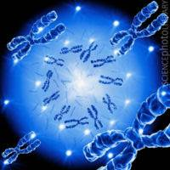
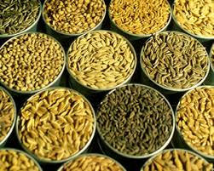
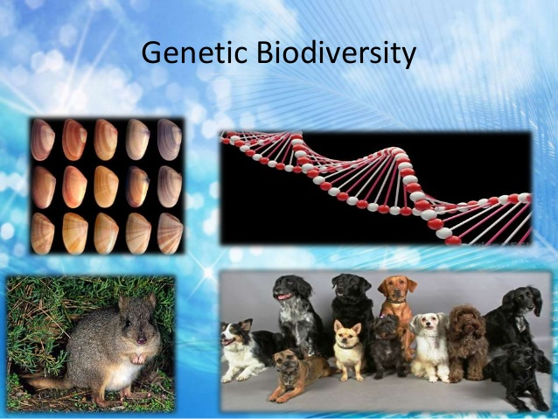
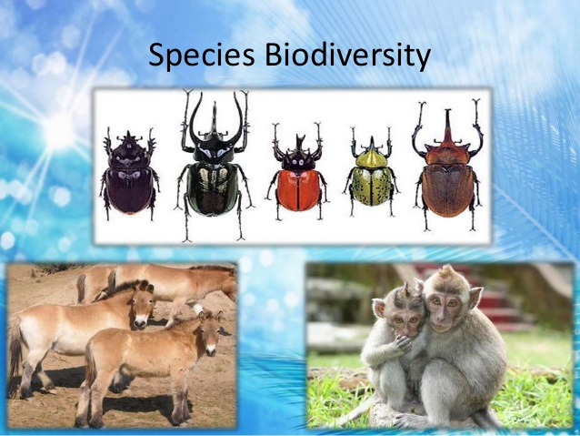
2. Genetic Biodiversity: It may be defined as variability in genes
of a particular species in a population
Recombination of gene (DNA) gives rise to some new variety
Each member of any plant and animals species differ from
others due to genetic recombination.
  all rice varieties
  Today the new varieties created By genetically manipulation of DNA
  i) Disease resistant, Drought resistance crops
  ii) Breed superior domestic animals (high yield Caws, plants)
  iii) Better medicines and a variety of industrial products are
  also developed.
Types of Biodiversity
All rice, dog, insect varieties, on colour, size , shape etc

Slide 6
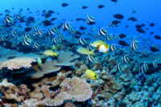
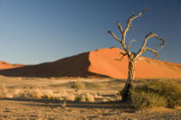
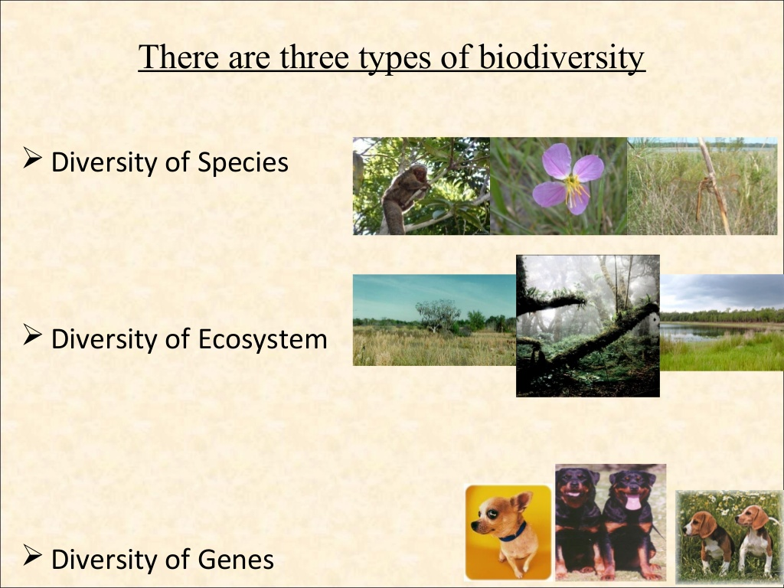
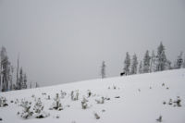
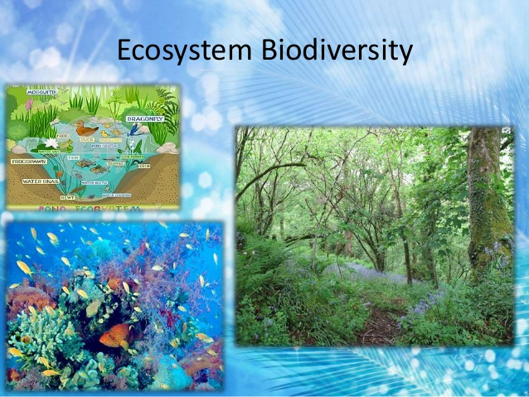
Types of Biodiversity
(3) Ecosystem Biodiversity:
This is the diversity of ecological complexity showing variations in ecological tropic structure, food chain food-webs, nutrient cycling resulted different variety of Ecosystem.
variations is caused by change in physical parameters like hydrosphere, atmosphere, and lithosphere, moisture, temperature, altitude, precipitation etc.
E.g. Forest, Grassland, Desert, Pond ecosystems.
Ecosystem: Integration of biotic and abiotic components of a particular environment and their interaction with each other
Marine Ecosystem
Desert Ecosystem
Tundra Ecosystem
Forest Ecosystem

Slide 7
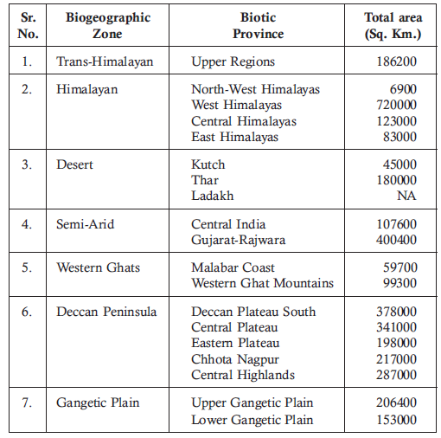
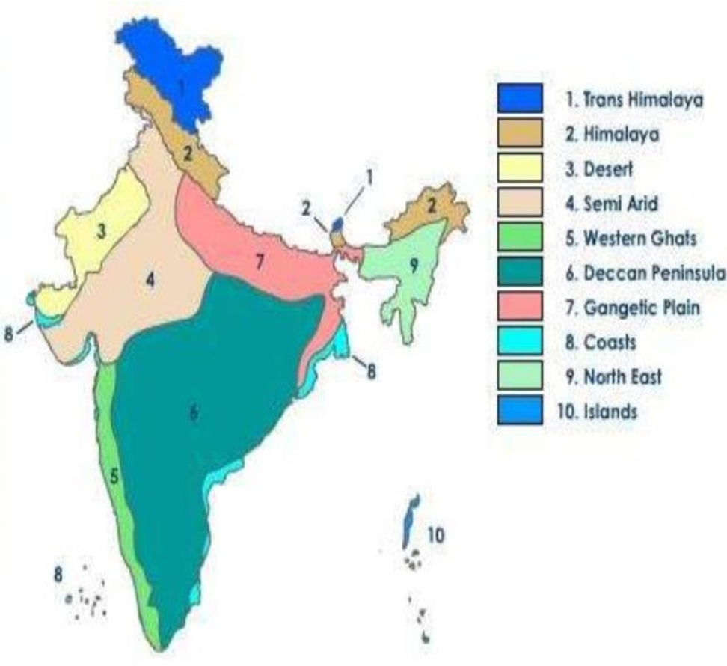
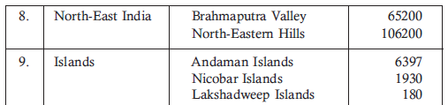
Biogeographic Classification of India
India is divided in to 10 major regions based on geography, climate, vegetation pattern, mammals, birds, reptiles, amphibians, insects and other invertebrates present in them.
8 | Coast | East coast and waste coast | 6500 6500
8
9
98
10
Source: .Conserving our Biological Wealth., WWF for Nature-India and Zoological Survey of India.
8

Slide 8
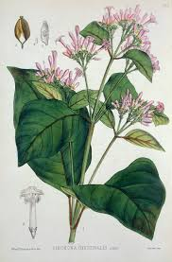
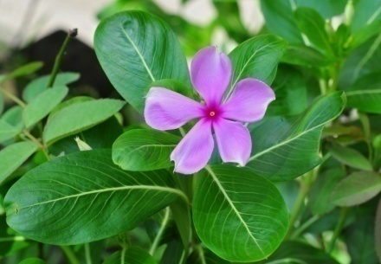
Values of Biodiversity
Direct values (Consumptive uses)
Food, fuel, medicines for local community –forest ecosystem.
Food: Fish, other edible aquatic plants and animals – Marine resources
Medicines
2. Productive use value: These are the commercially usable values
where the product is marketed and sold.
Animal products: like tusks of elephants, musk from musk deer, silk from silk-worm, wool from sheep, fir of many animals, lac from lac insects etc
Pharmacist – New and better drugs/medicines
Raw material for Industry – the paper and pulp industry, Plywood industry, Railway sleeper industry, Silk industry, textile industry, leather industry
Agricultural – Developing new crops Better crops with plant breeding
Vinblastin and vincristine, two anticancer drugs, from Catharanthus roses plant
Quinine for malaria from the bark of Cinchona tree,

Slide 9
Values of Biodiversity
3. Social Values:
Preserved as valuable resource many sacred and holy plants like- based on religion worship: Tulsi, Peepal, and animals like Cow.
4. Ethical and Moral values: Ethical responsibility to protect all life forms.
Preservation of nature through local traditions.
Conservation of biodiversity & economic importance.
5. Aesthetic Values: Preservation of its inherent value, beauty, aesthetics and creativity for tourist attraction.
Indian mythology eulogies animals like elephant, snake and cow.
No visit to barren land but to enriched biodiversity promote eco- turism Industry.
6. Option Value: Keeping future possibilities open for their use is called the option value. In nature many thing yet to explore, plant , microorganism.
The preservation of biodiversity must also include traditionally used strains already in existence in crops and domestic animals.

Slide 10
Indian Biodiversity
India has a rich biological diversity of flora and fauna.
Overall 6% of the global species are found in India.
India ranks 10th among the plant rich countries of the world,
11th in terms of number of endemic species of higher vertebrates
6th among the centers of diversity and origin of agricultural crops.
The total number of living species identified in our country is 150,000.
Out of a total of 25 biodiversity hot-spots in the world, India possesses 02
i) Eastern Himalayas (North east Sikim Region)
Ii) western ghats

Slide 11
INDIA AS A MEGA-DIVERSITY NATION
India is one of the 12 mega-diversity countries in the world.
The Ministry of Environment and Forests, Govt. of India (2000) records
47,000 species of plants (7% of world )and 4th in Asia
81,000 species of animals (6.5% of world ).
350 mammal species – 8th in the world
1200 bird species – 8th in the world
453 reptile species -5th in the world
45,000 plant species – 15th in the world
Endemism: Species which are restricted only to a particular area are known as endemic.

Slide 12
INDIA AS A MEGA-DIVERSITY NATION
18% Indian plants are endemic to the country and found nowhere in the world
62% amphibians are endemic
50% of the lizards are endemic
Gene banks have collected - 34,000 cereals
- 22,000 pulses
- 27 breeds of cattle
- 40 breeds of sheep
- 22 breeds of goat
- 8 breeds of buffalos
Many of these are dying out due to misguided adoption of all foreign things.
MOEF is the nodal agency for implementation of CBD in India.
National Biodiversity Action Plan (NBAP) was formulated in 2007

Slide 13
INDIA AS A MEGA-DIVERSITY NATION
Center of origin:. Nearly 5000 species of flowering plants had their origin in India.
center of origin of 166 species of crop plants and 320 species of wild relatives of cultivated crops,
Marine diversity: Along 7500 km long coastline
More than 340 species of corals. rich in mollusks, crustaceans (crabs etc.),
Several species of Mangrove plants and sea grasses (Marine algae).
93 major wet lands, coral reefs and mangroves need to be studied
Indian forests cover 64.01 million hectares having a rich biodiversity of plants in the Trans-Himalayan, north-west, west, central and eastern Himalayan forests, western ghats, coasts, deserts, Gangetic plains, deccan plateau and the Andaman, Nicobar and Lakshadweep islands.

Slide 14
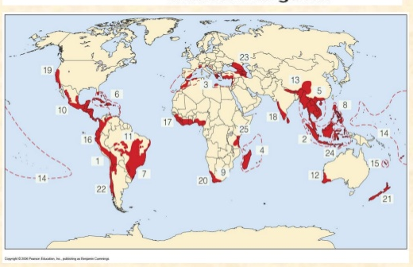
HOT SPOTS OF BIODIVERSITY
Areas which exhibit high species richness & high species endemism are termed as hot spots of biodiversity.
25 hot spots in world and 2 in India
Eastern Himalayas, & Western Ghats
.
About 40% of terrestrial plants and 25% of vertebrate species are endemic and found in these hotspots.
Major hot spot in world i) Tropical rain forests ii)Western Amazon, iii) Madagascar, iv)North and East Borneo, v) North Eastern Australia,
vi) West Africa vii) Brazilian Atlantic forests.
Hotspots covering less than 2% of the worlds land area contain 50% of the terrestrial biodiversity
Centre of Global biodiversity (Red )

Slide 15
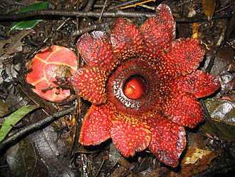
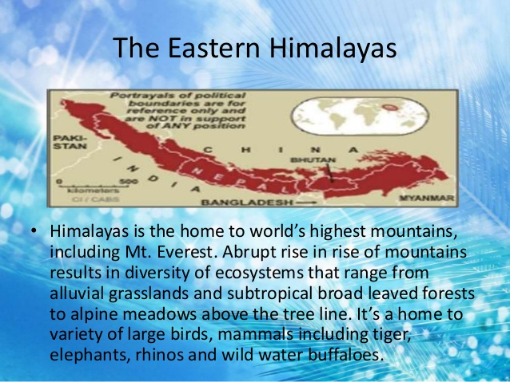
HOT SOPT BIODIVERSITY IN INDIA
1. Indo-Burma region (covering Sikkim Eastern Himalayas)
Sikkim rich in endemic plant species. Area of 7298 Km² of about 4250 plant species are found of which 60% are endemic.
Sapria himalayana, aparasitic angiosperm was sighted only twice in this region in the last 70 years.
Cradle of flowering plants.
Out of the world's recorded flora 30% are endemic to India of which 35,000 are in the Himalayas.

Slide 16
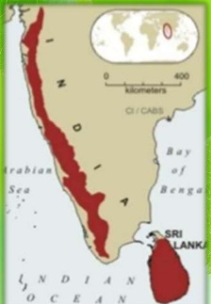
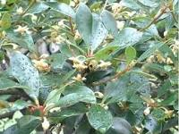
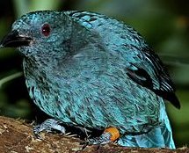
HOT SOPT BIODIVERSITY IN INDIA
(2) Western Ghats: It extends along a 17,000 Km²
strip of forests in Maharashtra, Karnataka, TN & Kerala
40% of the total endemic plant species.
62% amphibians and 50% lizards are endemic
500 m elevation covering 20% of evergreen forest while those in 500-1500 m range are semievergreen.
Major centers of diversity are Agastyamalai Hills and
Silent Valley. the New Amambalam Reserve Basin
Endemic plant and animals in western ghat:
Ternstroemia japonica, Rhododendron and Hypericum
Fairy blue bird, lizard hawk etc.
Ternstroemia japonica
However, only 6.8% of the original forests are existing today while
the rest has been deforested
Fairy blue bird

Slide 17
Thank You

